Slide 1
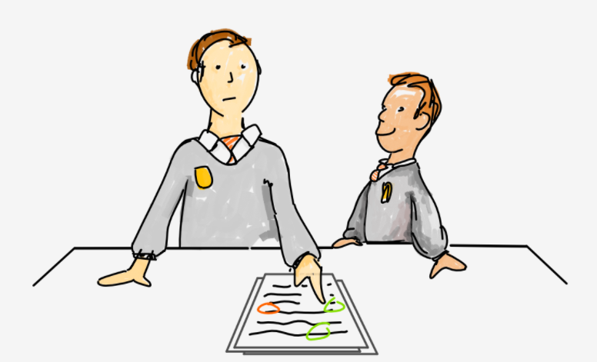
PEER GRADE SYSTEM
Nayan Mandliya
1911027

Slide 2
INTRODUCTION
Peer grade system is a system of learning whereby students assess and give feedback on one another's work.
It is a great way to improve students understanding of a subject and improve their critical thinking and of course, it can help to save a teacher’s time!
The peer-assessment mechanism is also the gold-standard in many creative tasks varied from reviewing the quality of scholarly articles or grant proposals to design studios.

Slide 3
ADVANTAGES
Better understand assessment criteria:- By grading their peers’ work, a student is compelled to get to know the mark scheme and the requirements of an assessment.
Learn from others:- By marking a really good bit of work, a student can pick up on techniques and traits from their peers and start to use them in their own work. Conversely, a student can learn from the mistakes of others.
Judgement skills:- Students are able to learn the art of judging others and effectively giving feedback - a skill that is often overlooked in schools, but hugely important in the world of work.
Development of critical thinking:- It can improve a students ability to evaluate and analyze work and draw proper conclusions, again, a skill that is hugely important in later life!

Slide 4
PROBLEM DEFINITION
A teacher has lot of work to do other than checking the assignments of students and also students doesn’t have exact idea of how the teacher is checking assignments and giving marks.
So there must be a system which will reduce some work for teachers and also helps students to gain the knowledge of assignment checking.

Slide 5
SCOPE
A new student can register with his roll number
Teacher can create assignment, view all submissions, view all assignments created and also mark the assignments that are submitted
Students can submit the assignments that are created
Students can mark the assignment that are submitted by classmates
Student will be able to see marks after receiving marks from their peers and teacher
A simple console based application including all the above functionalities

Slide 6


TECHNOLOGIES USED
PYTHON
MYSQL

Slide 7
CONCEPTS USED
Database Connectivity
Control Structures
Modules in python
Exception Handling
Functions and classes
Data Structures

Slide 8
CONCLUSION
Peer grade systems are very much useful for teachers and students as they are reducing work load of teachers and also helps students to gain knowledge of assessment.
This type of complex systems can be easily made using python and its different functionalities.
Python is a very powerful language as with the help of python we can create web applications, games, etc
MySQL will be the great choice for the project like this due to its easy connectivity with python.

Slide 9
REFERENCES
https://en.wikipedia.org/wiki/Peer_assessment
https://vizi.education/blog/peer-to-peer-grading
https://docs.python.org/3/
https://www.w3schools.com/python/python_mysql_getstarted.asp

Slide 10


Slide 11

DEMO

